Slide 1
Task Report
on
Visualization
of
GDP Break-up
(Agriculture & Industry Sectors)
(Prepared by: Biswas Kumar)
Reference Notebook

Slide 2
Content
Data Description
Time and 55 Indicators
Dataset Cleaning & Statistics
GDP BreakUp of Nigerian Economy
Sectors and Subsectors
Data Visualization
Histograms and Boxplots
Data Visualization- Univariate Analysis
Graph of Indicators
Data Categories (GDP Break-up) of the Datasets
Sector and Subsector Analysis
Graph of Sectors and subsectors
Correlation Analysis
Correlation Analysis (Heatmap) of Dataset

Slide 3
Data Description (1/4)
S.No | Indicators | Description
0 | Time | Timestamp mentioned as year in integrer format, converted to datetime format during preprocessing.
1 | Agriculture | It includes important sub sectcors like Miningand Quarrying, Manufacturing, Electric & Gas, water Supply & Construction Industry.
2 | Crop Production | Measures the quantity of agricultural crops produced, essential for food supply
3 | Livestock | Refers to the breeding and raising of animals for food and other products
4 | Forestery | Involves the management and harvesting of forest resources
5 | Fishing | Encompasses the capture and cultivation of fish and seafood
6 | Industry | Industry in Nigeria includes vital subsectors such as mining and quarrying, manufacturing, electric and gas supply, water supply, wastewater management, and construction
7 | Mining and Quarrying | Mining and quarrying in Nigeria involve the extraction of valuable minerals and resources, including crude petroleum, natural gas, coal, metal ores, and various non-metallic minerals such as limestone and sand.
8 | Crude Petroleum and Natural Gas | This sector involves the extraction and production of crude oil and natural gas, which are critical energy resources.
9 | Coal Mining | Coal mining encompasses the extraction of coal from underground or surface mines.
10 | Metal Ores | The metal ores sector involves mining and processing metals such as tin, iron, lead, and zinc.
11 | Quarrying and Other Minerals | This sector includes the extraction of various non-metallic minerals like limestone, sand, and gravel.
12 | Manufacturing Industry | It measures the economic output of the manufacturing sector
13 | Oil Refining | Oil refining involves the processing of crude oil into various petroleum products like gasoline, diesel, and kerosene.
14 | Cement | The cement industry produces cement used in construction and infrastructure projects.
15 | Food, Beverage and Tobacco | This sector includes the production and processing of food, beverages, and tobacco products.
16 | Textile, Apparel and Footwear | This industry involves the production of textiles, clothing, and footwear.

Slide 4
Data Description (2/4)
S.No | Indicators | Description
17 | Wood and Wood Products | This sector includes the processing of wood into products like furniture, paper, and construction materials.
18 | Pulp, Paper and Paper Products | This industry produces paper and related products from pulp
19 | Chemical and Pharmaceutical Products | This sector involves the production of chemicals and pharmaceuticals.
20 | Non-Metallic Products | This sector includes the production of non-metallic products like glass, ceramics, and concrete.
21 | Plastic and Rubber products | This industry produces plastic and rubber materials used in various applications.
22 | Electrical and Electronics | This sector includes the manufacturing of electrical equipment and electronic devices.
23 | Basic Metal, Iron and Steel | This industry involves the production of basic metals, iron, and steel products.
24 | Motor Vehicles & Assembly | This sector includes the manufacturing and assembly of motor vehicles.
25 | Other Manufacturing | This category encompasses various other manufacturing activities not classified elsewhere.
26 | Electricity,Gas,Steam & Air conditioner | This sector involves the generation, distribution, and supply of electricity, gas, steam, and air conditioning.
27 | Water Supply, Sewage, Waste Management | This sector includes the provision of water supply, sewage services, and waste management.
28 | Construction Industry | Measures the economic output of the construction sector, reflecting infrastructure development and housing supply
29 | Services | The services sector encompasses a wide range of activities including trade, accommodation, food services, transportation, storage, and various other service-oriented industries.
30 | Trade | This sector involves the wholesale and retail trade of goods and services.
31 | Accomodation and Food Services | This industry includes businesses providing lodging and food services, such as hotels, restaurants, and catering services.

Slide 5
Data Description (3/4)
S.No | Indicators | Description
32 | Road Transport | Road transport involves the movement of goods and passengers via roadways.
33 | Rail Transport & Pipelines | This sector includes the movement of goods and passengers via railways and the transport of liquids and gases through pipelines.
34 | Water Transport | Water transport involves the movement of goods and passengers via waterways, including shipping and ferry services.
35 | Air Transport | This sector includes the movement of goods and passengers via airways.
36 | Transport Services | Transport services cover a range of support services related to transportation, including logistics, freight forwarding, and passenger services.
37 | Post and Courier Services | This sector involves the delivery of letters, parcels, and other mail items through postal and courier networks.
38 | Information & Communication Service Sector | Measures the economic output of the information and communication technology services That includes publishing, Motion pictures, Broadcasting, Entertainment etc
39 | Publishing | The publishing sector involves the production and dissemination of literature, including books, newspapers, magazines, and digital content.
40 | MotionPicturesSoundRecordingAndMusicProduction | This industry encompasses the creation, production, and distribution of films, sound recordings, and music.
41 | Broadcasting | Broadcasting involves the transmission of audio and visual content via television, radio, and online platforms.
42 | ArtsEntertainmentAndRecreation | This sector includes activities related to the arts, entertainment, and recreational services, such as theaters, museums, sports, and amusement parks.
43 | FinanceAndInsurance | The finance and insurance sector includes a range of financial services and insurance products.
44 | Financial Institutions | Financial institutions include banks, credit unions, and other institutions that provide financial services.
45 | Insurance | The insurance industry provides risk management and financial protection through various insurance products.

Slide 6
Data Description(4/4)
S.No | Indicators | Description
46 | Real Estate Service Sector | Measures the economic output of the real estate services sector, indicating the health of property markets
47 | Professional, Scientific & Technical Services | This sector includes professional services such as legal, accounting, engineering, and scientific research.
48 | Administrative and Support Services | This sector provides support services to businesses, including office administration, facility management, and business support.
49 | Public Administration | Public administration includes government activities related to governance, policy implementation, and public service provision.
50 | Education | The education sector involves the provision of formal education and training services.
51 | Human Health & Social Services | This sector includes health care services and social assistance programs.
52 | Other Social Services | Other social services encompass a range of community and social support programs.
53 | GDP at 2010 Constant Basic Prices | GDP at 2010 Constant Basic Prices measures the total value of goods and services produced in an economy, adjusted for inflation to reflect 2010 price levels.
54 | Net Taxes on Products | Net taxes on products include indirect taxes (e.g., sales tax, value-added tax) minus subsidies on products.
55 | GDP at 2010 Constant Market Prices | GDP at constant market prices is a measure of economic output adjusted for inflation, using 2010 as the base year.
Unit:
Time (S.No 0) : Year, Int format for year which was converted to datetime format for year
Indicators (S.No 1-55) : Billion Naira (Nigerian Currency), Float data type

Slide 7
Dataset Cleaning & Statistics
Dimension of the dataset: 42 Rows & 57 Columns/ Indicators
Unit:
Time (S.No 0) : Year, Int format for year which was converted to datetime format for year
Indicators (S.No 1-55) : Billion Naira (Nigerian Currency), Float data type
The dataset has no missing values.
The dataset has no duplicate values.

Slide 8
GDP BreakUp of Nigerian Economy
GDP at 2010 Constant Basic Prices
Agriculture Sector
Industry Sector
Services Sector
Legends
Sector
Subsector
GDP at 2010 Constant Market Prices
GDP at 2010 Constant Basic Prices
NetTaxesOnProducts
Agriculture Sector | Industry Sector |  | Services Sector
CropProduction | MiningAndQuarrying | Manufacturing | Trade | ArtsEntertainmentAndRecreation
Livestock | CrudePetroleumAndNaturalGas | OilRefining | AccommodationAndFoodServices | FinanceAndInsurance
Forestry | CoalMining | Cement | TransportationAndStorage | FinancialInstitutions
Fishing | MetalOres | FoodBeverageAndTobacco | RoadTransport | Insurance
 | QuarryingAndOtherMinerals | TextileApparelAndFootwear | RailTransportAndPipelines | RealEstate
 | ElectricityGasSteamAndAirCon | WoodAndWoodProducts | WaterTransport | ProfessionalScientificAndTechnicalServices
 | WaterSupplySewageWaste | PulpPaperAndPaperProducts | AirTransport | AdministrativeAndSupportServicesBusinessServices
 | Construction | ChemicalAndPharmaceuticalProducts | TransportServices | PublicAdministration
 |  | NonMetallicProducts | PostAndCourierServices | Education
 |  | PlasticAndRubberProducts | InformationAndCommunication | HumanHealthAndSocialServices
 |  | ElectricalAndElectronics | Publishing | OtherServices
 |  | BasicMetalIronAndSteel | MotionPicturesSoundRecordingAndMusicProduction
 |  | MotorVehiclesAndAssembly | Broadcasting
 |  | OtherManufacturing
Reference:https://www.cbn.gov.ng/rates/RealGDP.asp

Slide 9
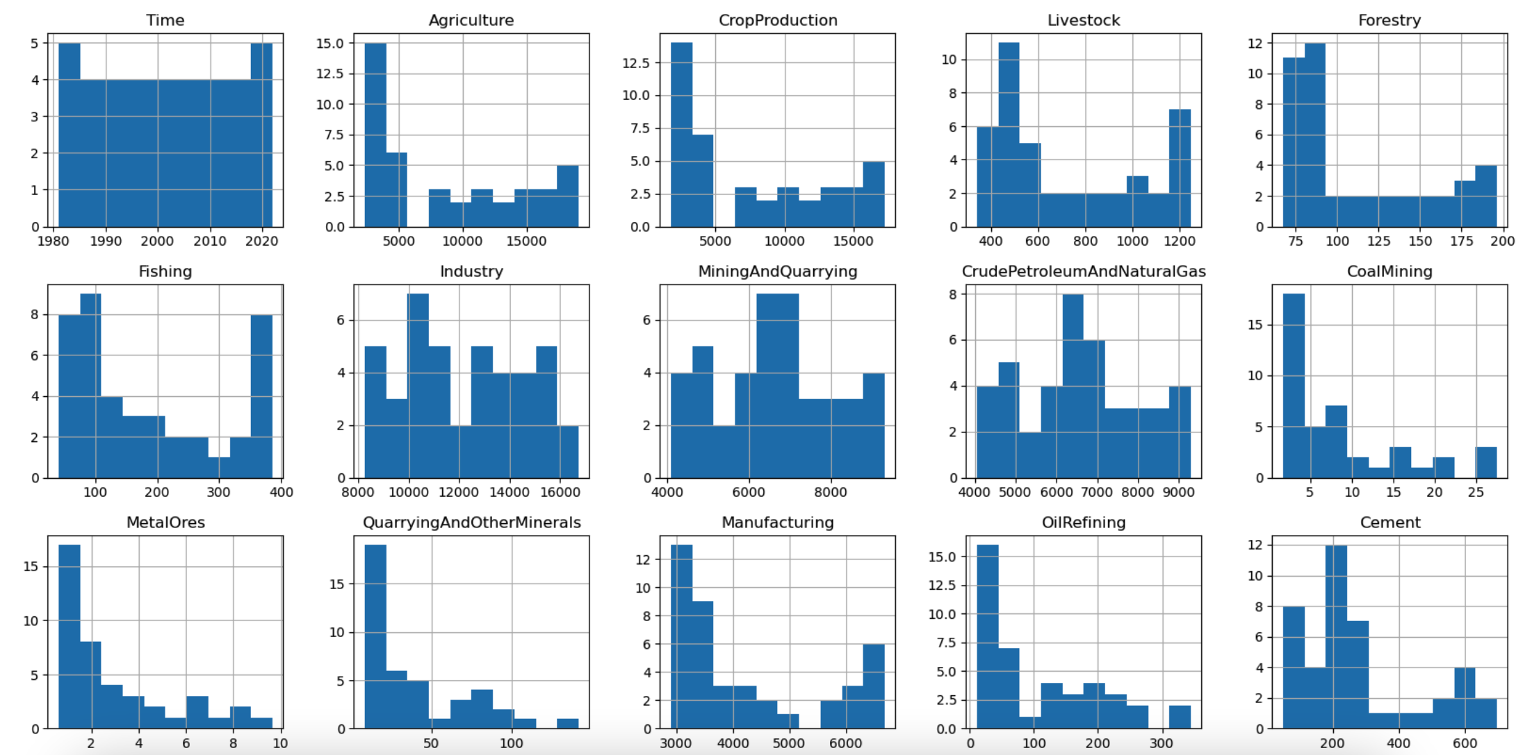
Data Visualization (1/3)
Histograms
The distribution of an indicator datasets shown by the frequency of data points.
Observation 1:
Most data points have a higher frequency towards the beginning of the bins.
"Time" exhibits a uniform distribution due to the non-repetitive nature of the years.
Conclusion 1:
The higher frequency at the start indicates that the dataset contains more lower values.

Slide 10
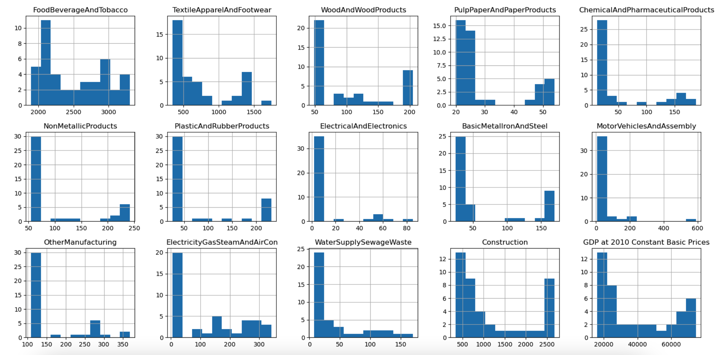
Data Visualization (2/3)
Observation 2:
Mining and Quarrying, Crude Production, and Cement show higher frequencies towards the middle of their respective histograms.
Conclusion 2:
These sectors/sub-sectors of industries have more consistent outputs over the years compared to others.

Slide 11
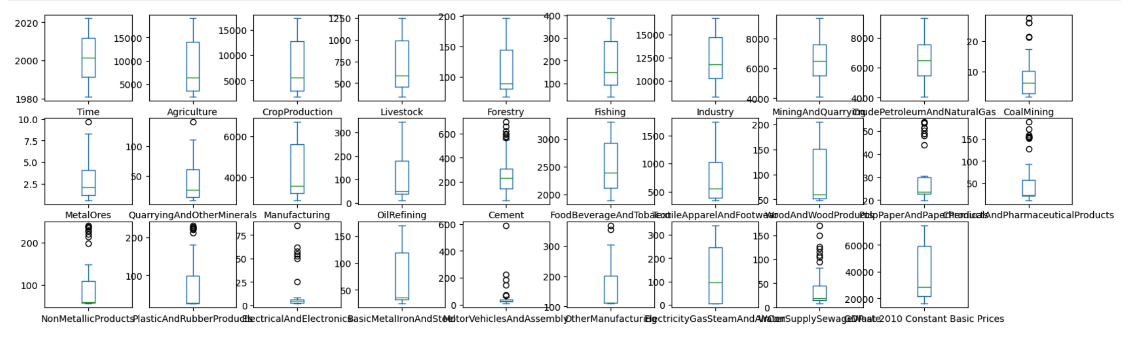
Data Visualization (3/3)
Boxplots
The boxplots of indicators signify the distribution of the dataset, including the presence of outliers.
Observations:
Most indicators display good symmetry and have no significant outliers. However, Coal Mining, Paper Products, Chemical Products, Plastics, Electricals, Motor Vehicle Assembly, and Water Supply, exhibit a few outliers.
Conclusions:
These indicators require further investigation during univariate analysis.

Slide 12
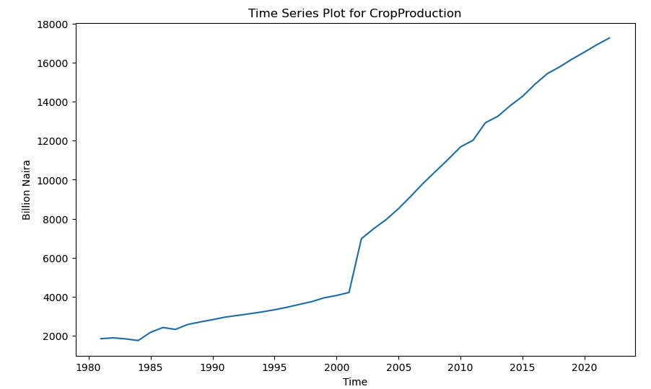
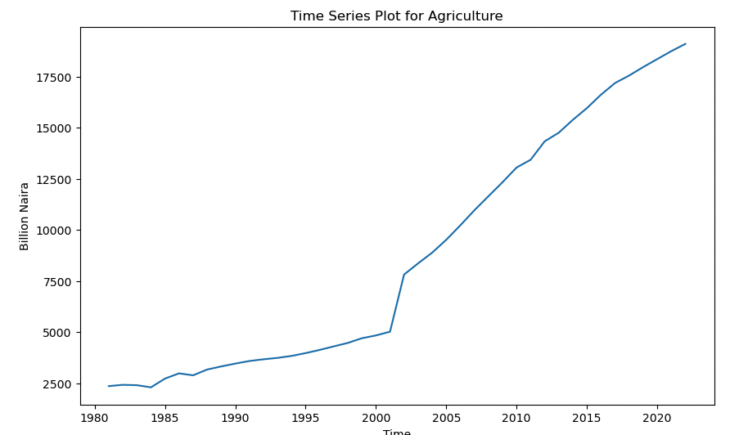
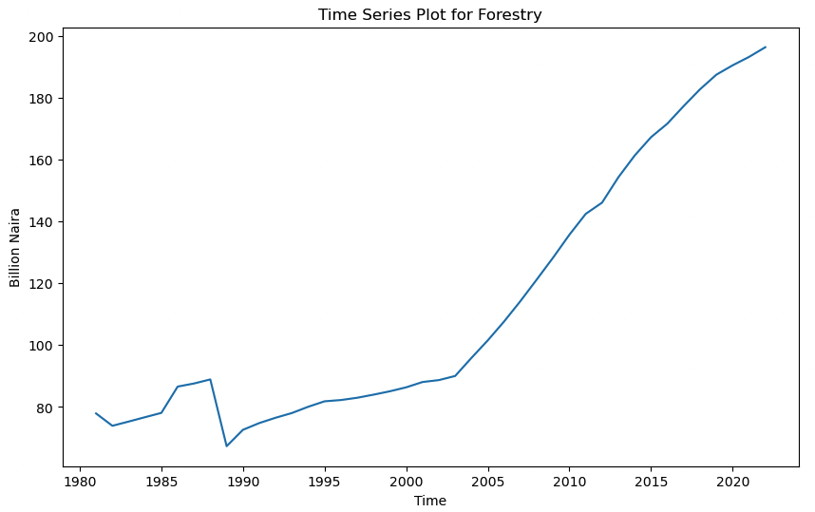
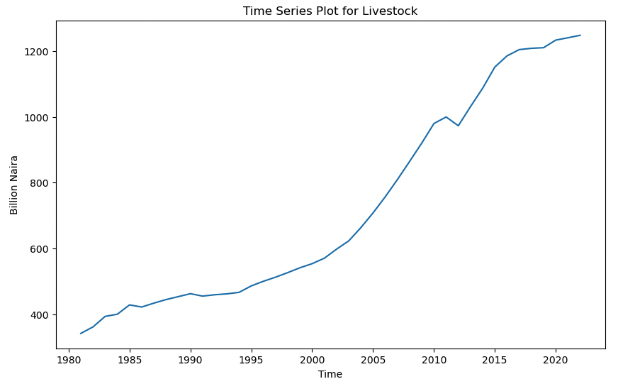
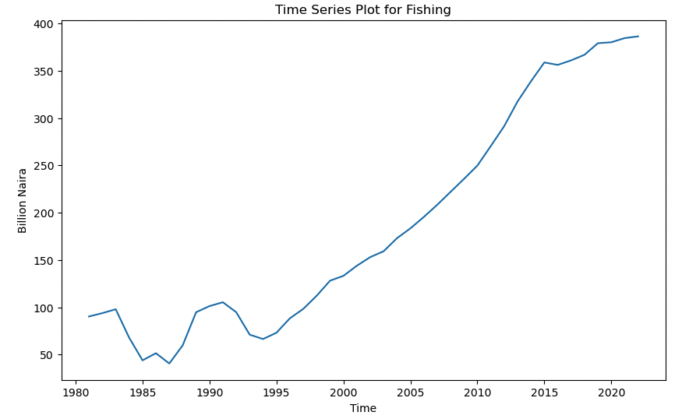
Data Visualization- Univariate (1/6)
Indicators such as Agriculture, Crop Production, Forestry, Livestock, and Fishing show an upward trend since 1981.
It was noted that the period from 1980 to 2000 shows a steady increase, followed by a significant upward trend starting from the year 2000 onwards.

Slide 13
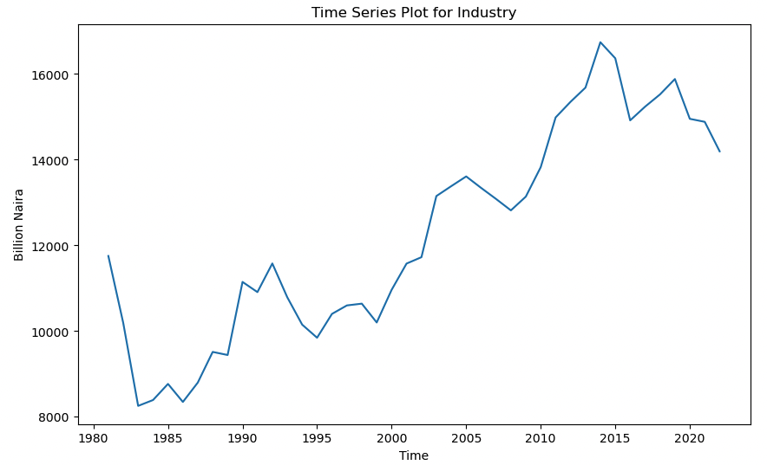
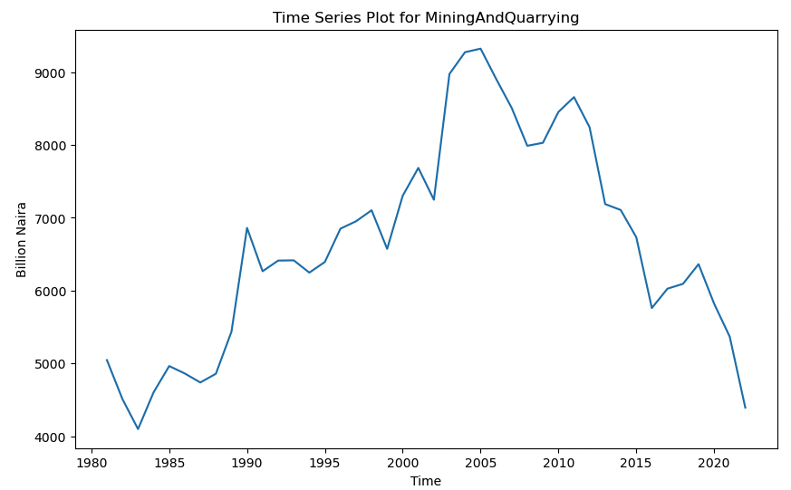
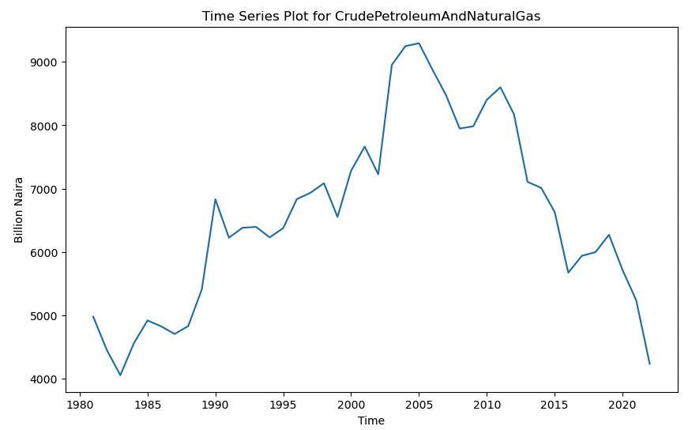
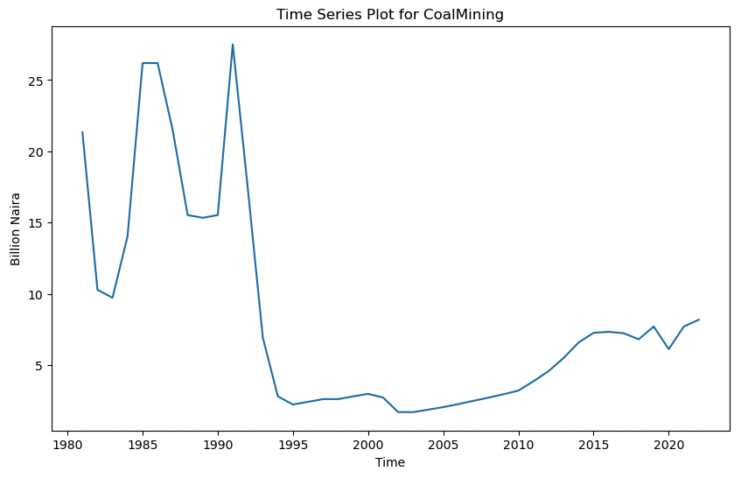
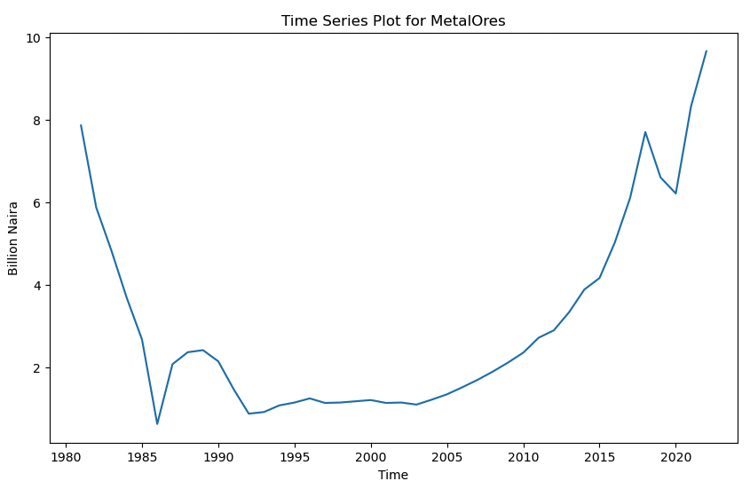
Data Visualization- Univariate (2/6)
Industry peaked near 2015 after a rapid increase starting in 1985.
Mining and Quarrying followed a bell curve trend during the years under investigation, peaking in 2005 and almost retracing back to 1984 levels. This trend was similar for Crude Petroleum and Natural Gas.
Coal mining spiked between 1985 and 1991, then fell abruptly from 1992 to 1995. After reaching its lowest value in 2002, it slowly started to recover, justifying the retention of the outliers observed in the boxplot.
Metal Ores displayed a very different trend compared to its peer industry indicators, resembling an inverse bell curve. After an initial decline and reaching its lowest value in 1985, it experienced a breakout around 2005 and continued to trend upward into 2022.

Slide 14
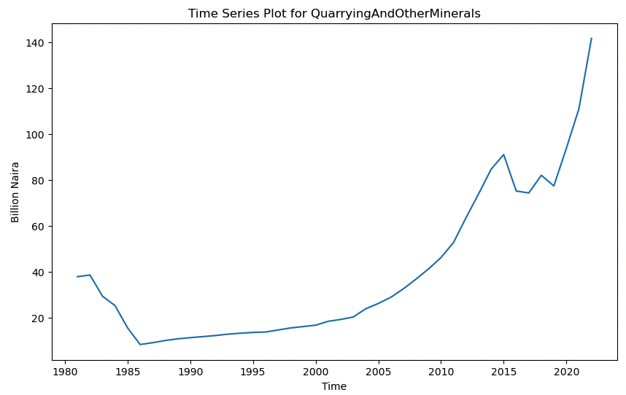
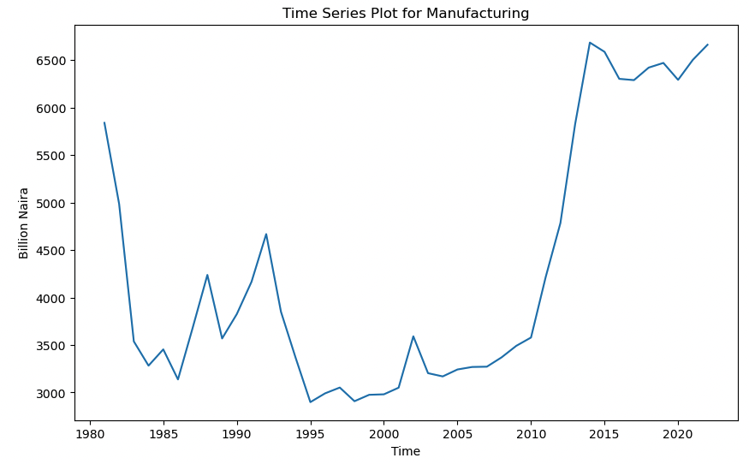
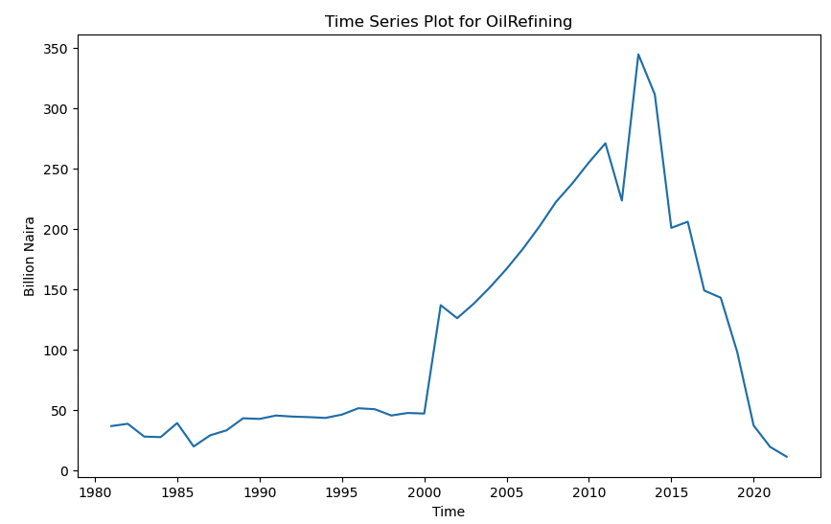
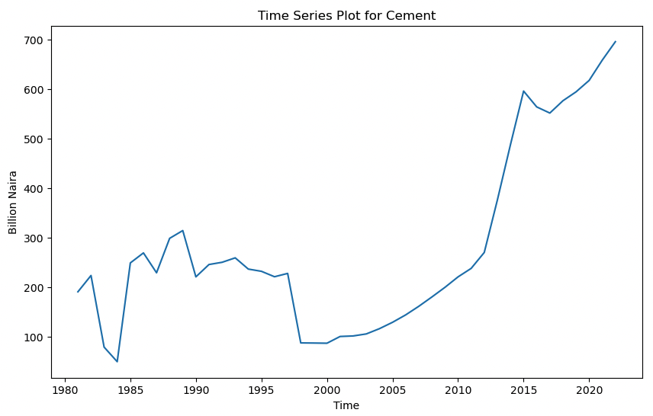
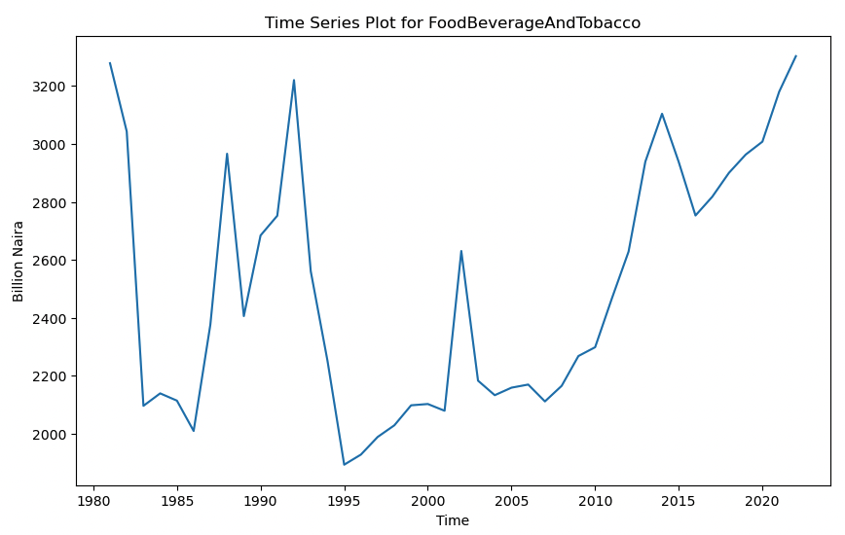
Data Visualization- Univariate (3/6)
Quarrying and other Minerals registered an uptrend since their lowest values in 1985, continuing to rise until the reported year, 2022.
Manufacturing initially declined from 1981, reaching its lowest value in 1995 in terms of GDP contribution. However, it began an uptrend around the year 2000 and was still strong in 2022.
After an initial period of constant output, Oil Refining saw a breakout in the year 2000, peaking around 2014. It then fell sharply, accounting for the lowest value addition in 2022.
Cement experienced initial fluctuations and began its uptrend from 2000 onwards, continuing to be strong in 2022.
Food, Beverage, and Tobacco showed significant fluctuations, with the lowest value registered in 1995 and the highest in 2022, marginally above the 1981 level.

Slide 15
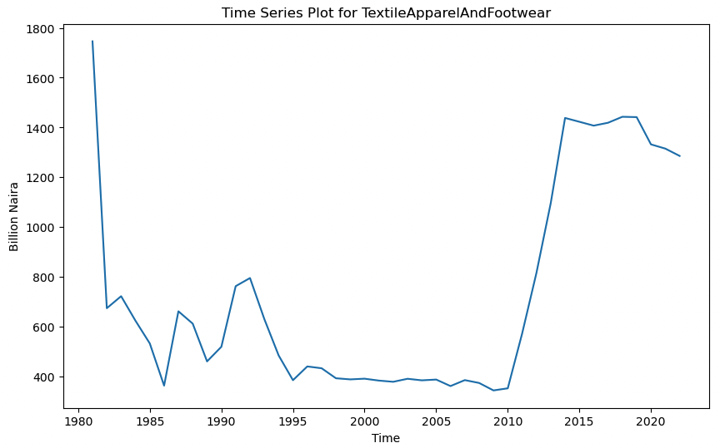
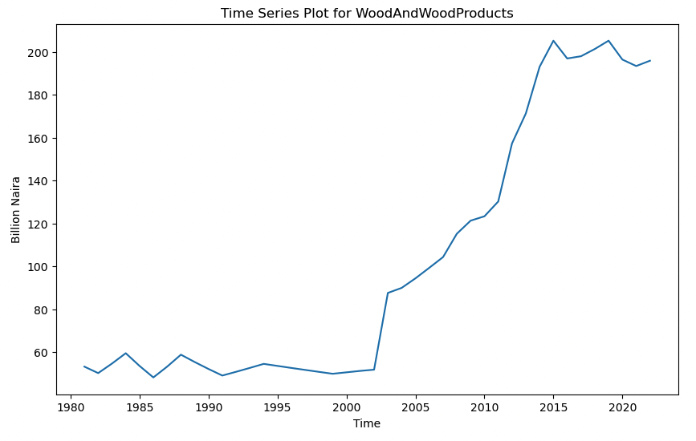
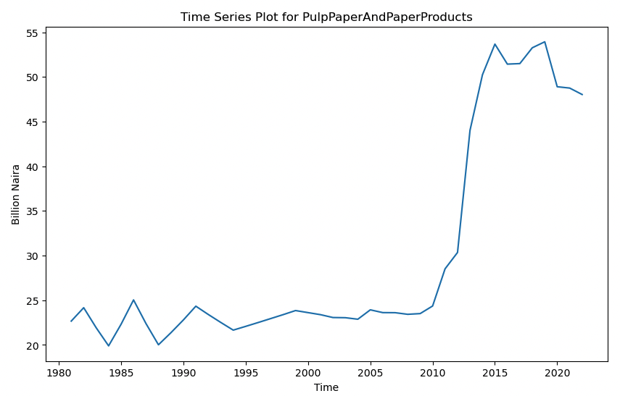
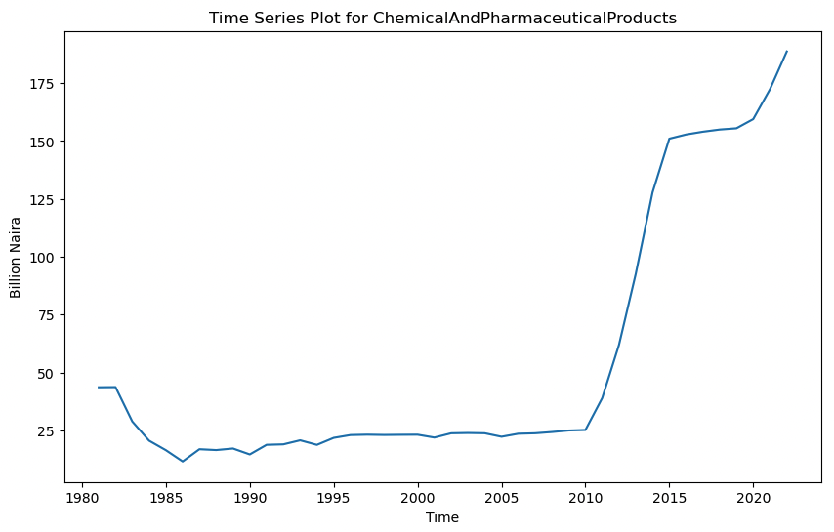
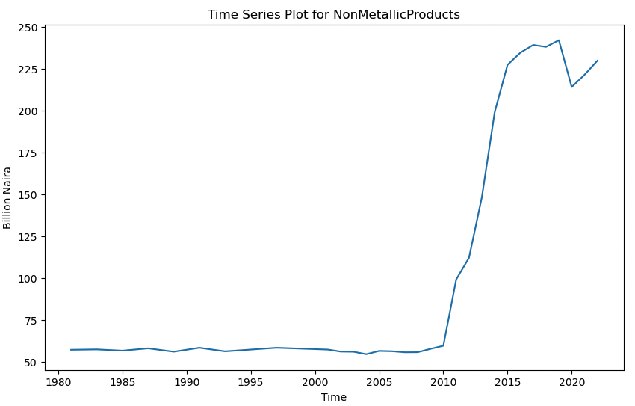
Data Visualization- Univariate (4/6)
There was a steep fall in Textile, Apparel, and Footwear from 1981 to 1985. After some fluctuations and a long period of consolidation, it broke out in 2010, but has been in a downtrend again since 2018.
Wood and Wood Products, Pulp Paper and Paper Products, Chemical Products, and Non-Metallic Products followed a very similar pattern.
Wood and Wood Products broke out abruptly after 2002, while the others registered similar breakouts around the year 2010.
Therefore, the related indicators appear to have outliers in the boxplots, but retaining them is justified.

Slide 16
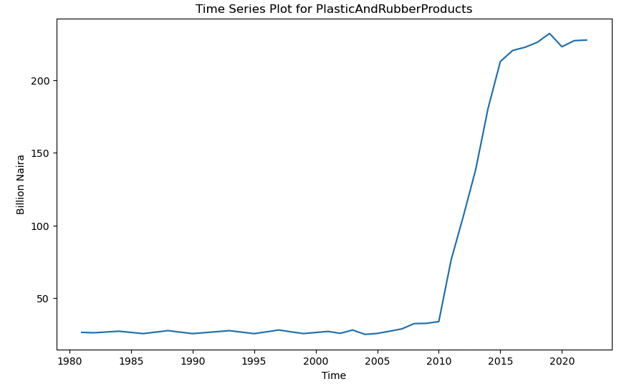
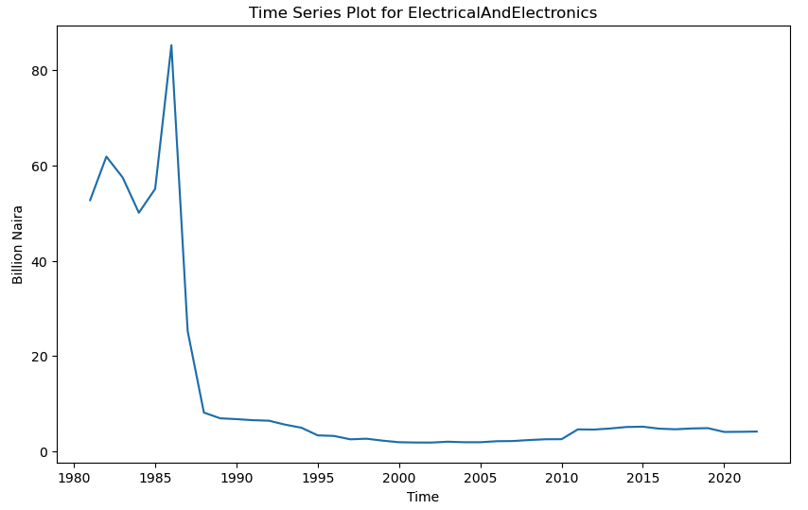
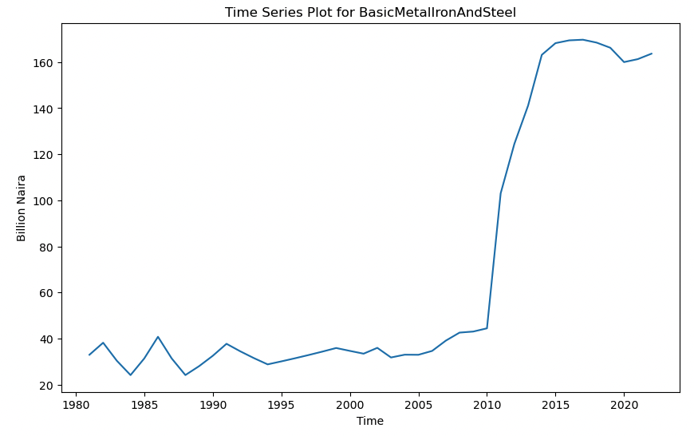
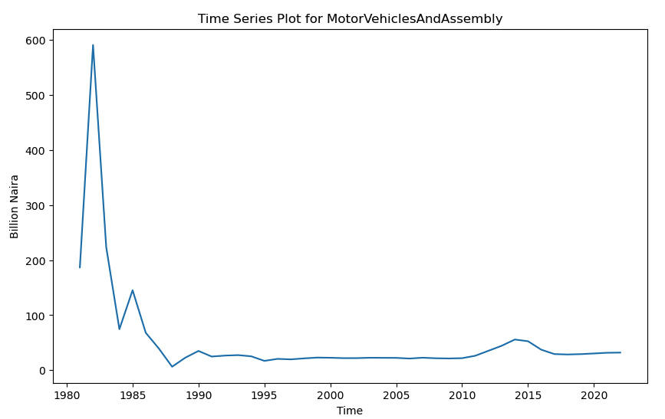
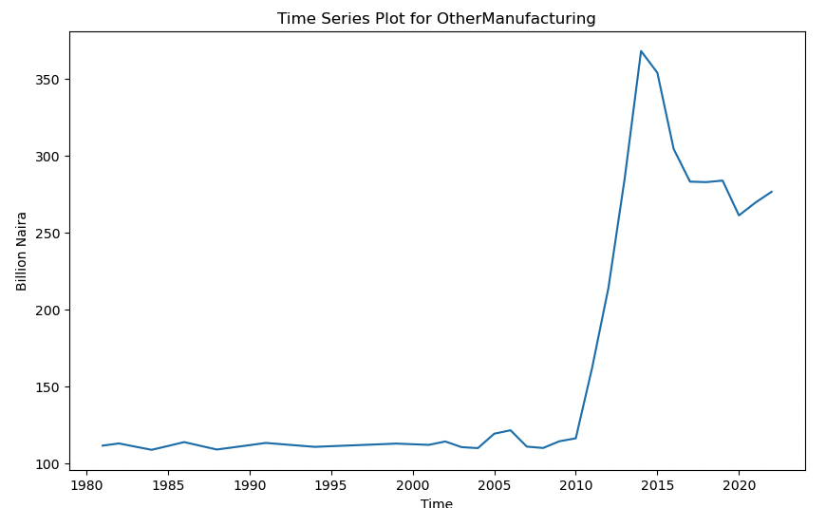
Data Visualization- Univariate (5/6)
Plastic and Rubber Products, Metal Iron and Steel, and Other Manufacturing exhibited similar trends, with breakouts around 2010.
In contrast, Motor Vehicles and Assembly, as well as Electrical Products, showed a declining trend initially and never recovered.

Slide 17
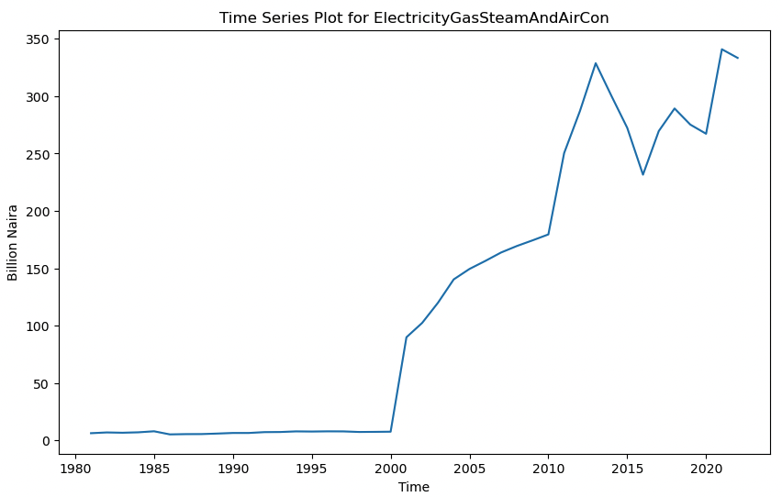
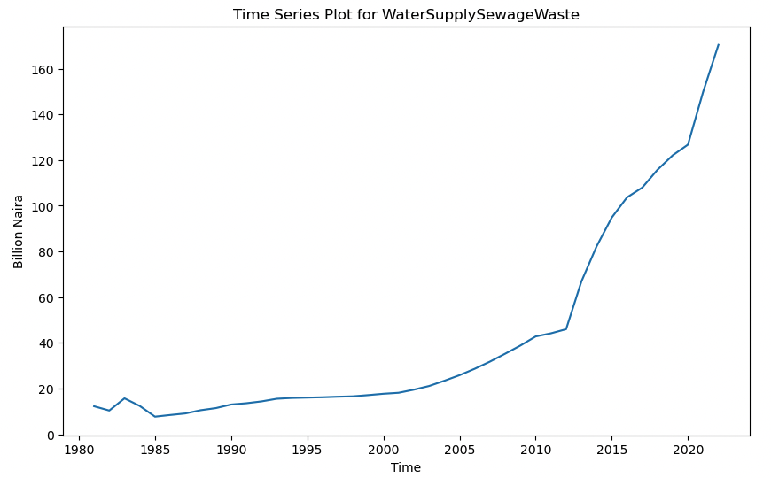
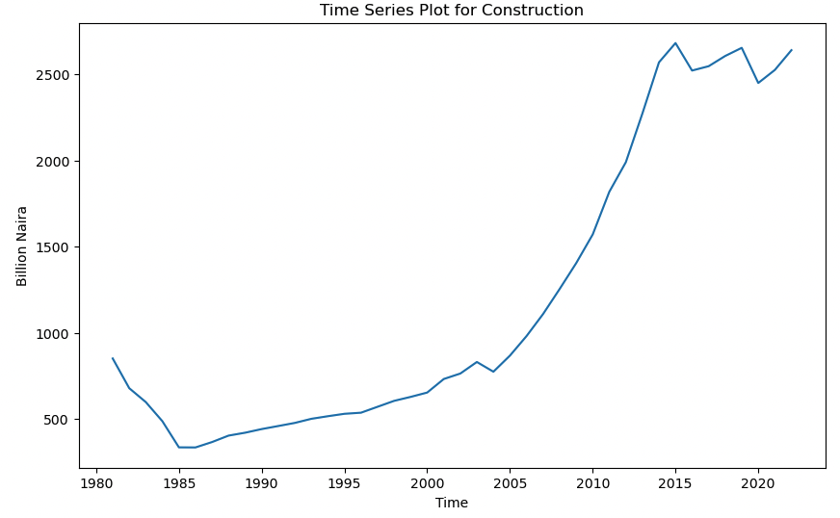
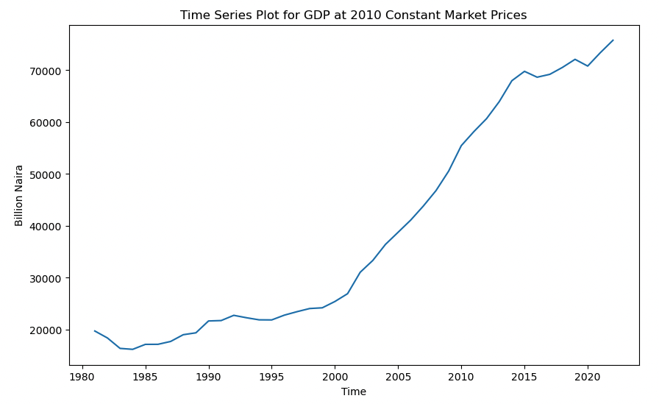
Data Visualization- Univariate (6/6)
Electricity and Gas abruptly broke out in the year 2000 and have been on an uptrend since.
Indicators such as Water Supply, Construction, Services, and Trade showed very similar charts and have been rising exponentially since the year 1995.
GDP at market price shown a similar uptrend.

Slide 18
Data Categories (GDP Break-up)
The datasets were categorized into different sectors based on GDP breakdown, originating from the Central Bank of Nigeria (CBN).
This categorization served as an expert knowledge base for gaining insights, as all these indicators were aggregated by CBN to derive Nigeria's GDP figures.
These different Sectors and subsectors were :
Agriculture Sector
Industry Sector
Industry Mining Subsector
Industry Manufacturing Subsector
Services Sector
Services Transportation Subsector
Services Information Subsector
Services FinanceInsurance Subsector
The task was to visualize for two sectors only (Agriculture and Industrial).

Slide 19
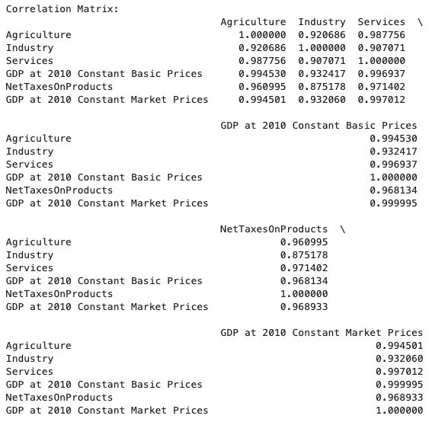
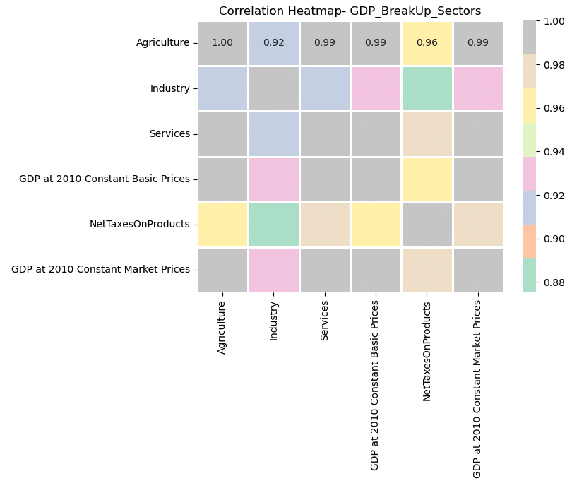
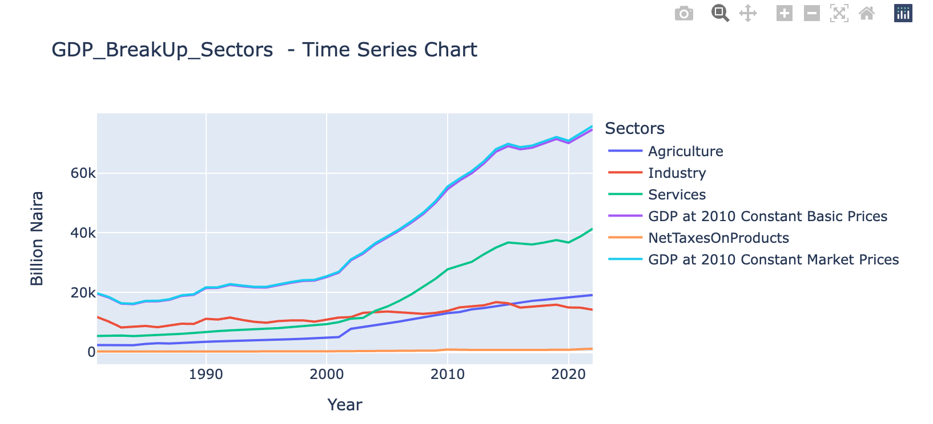
Data Analysis- GDP Sectors
The Services Sector surpassed the Industry Sector around 2002 to become the main contributor to GDP, experiencing significant growth thereafter.
The Industry Sector initially was the top contributor to GDP, fell to second place around 2002, and then to third place after the Agriculture Sector around 2015.
The Agriculture Sector started as the third-largest contributor but has been steadily rising over time and now stands as the second-largest contributor to Nigerian GDP.
Taxes on Products have minimal impact on GDP, resulting in GDP at market prices being only slightly higher than GDP at basic prices.
All these sectors show very high correlations with GDP. Services have the maximum correlation strength at 0.997, followed by Agriculture at 0.994, and Industry at 0.932. Higher correlation indicates a stronger relationship with GDP.

Slide 20
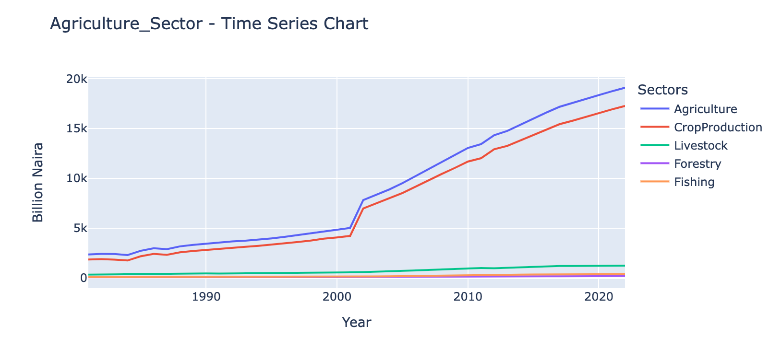
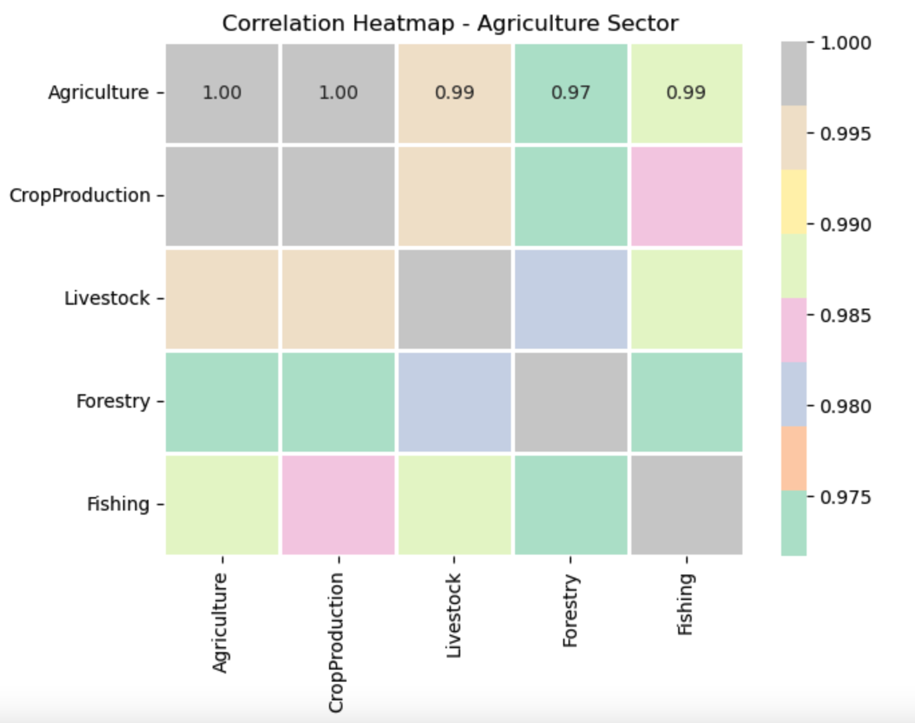
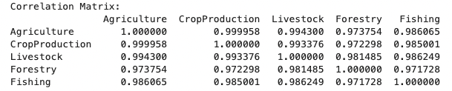
Sector and Subsector Analysis (1/4)
Agriculture Sector
Crop Production has been the dominant subsector within the Agriculture sector since 1981. It showed a rising trend and experienced a further breakout around the year 2000.
Other subsectors such as Livestock, Fishing, and Forestry were the second, third, and fourth contributors to this sector, respectively.
Agriculture has the highest correlation (0.999) with Crop Production, indicating a very strong relationship. This was followed by Livestock (0.994), Fishing (0.986), and Forestry (0.973), demonstrating their significant correlations with overall agricultural performance.

Slide 21
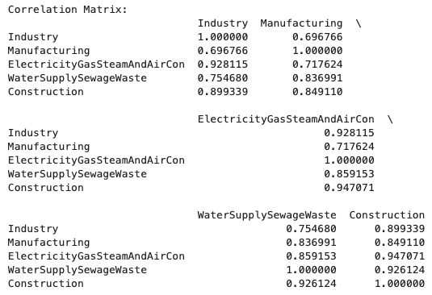
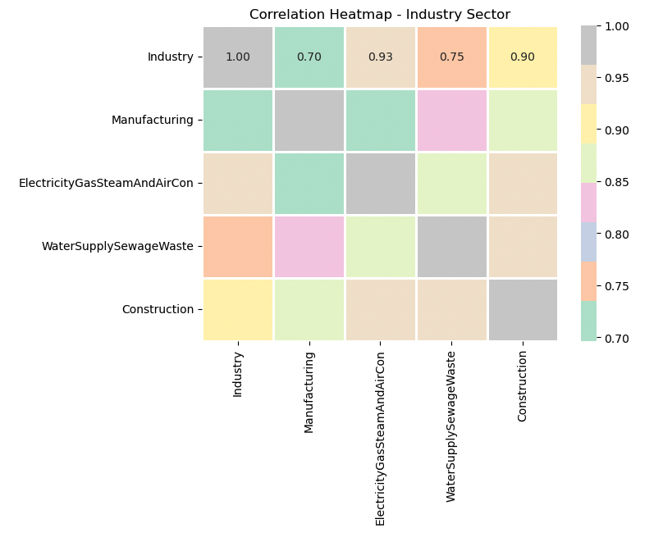
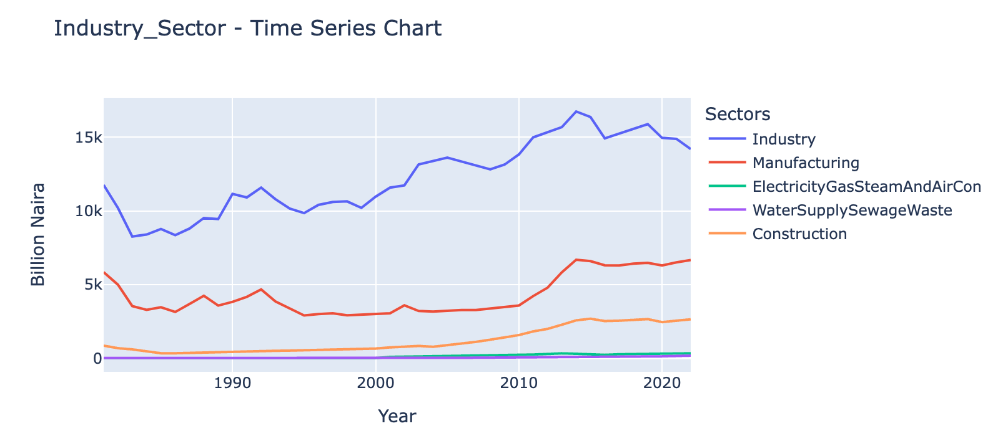
Sector and Subsector Analysis (2/4)
Industry Sector
Manufacturing leads the Industry sector, followed by contributions from Construction, Electricity and Gas, and Water Supply, respectively.
Electricity and Construction have a strong relationship with the Industry sector, followed by Water Supply and Manufacturing subsectors, indicating their significant impact on the overall industrial performance.

Slide 22
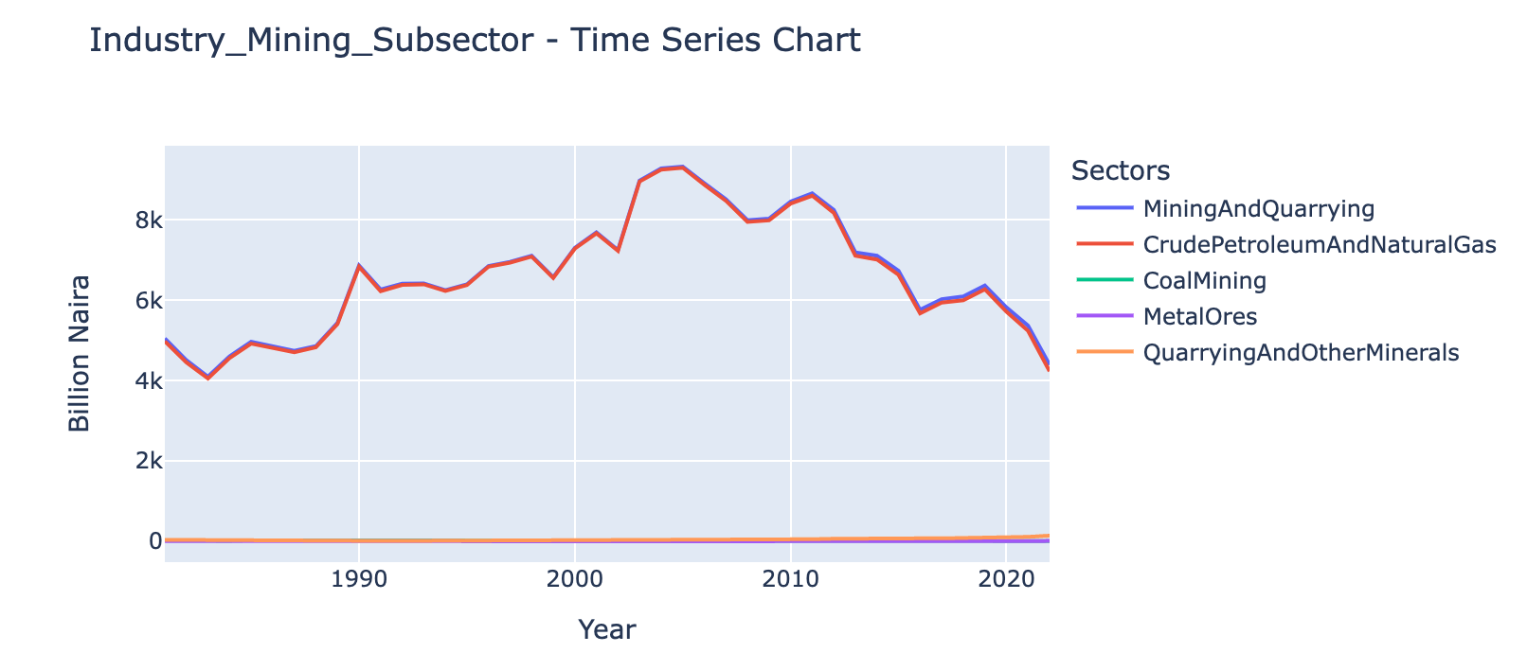
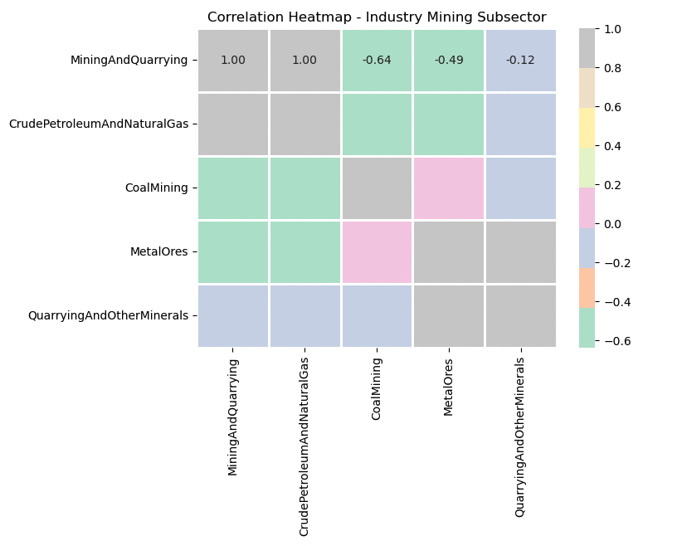
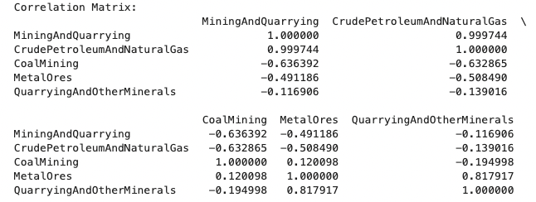
Sector and Subsector Analysis (3/4)
Industry Mining Subsector
Crude Petroleum and Natural Gas dominate the Mining subsector, overshadowing contributions from Quarrying and Other Minerals, Metal Ores, and Coal Mining.
The Mining sector experienced a healthy rise in trend since 1982, peaking around 2004, and has been on a downtrend since then.
Quarrying and Other Minerals showed an increasing trend over the years and continued to be on an uptrend in 2022.
Crude Petroleum subsector has the strongest positive relationship with the Mining Sector, whereas all other subsectors show negative correlations, indicating varying impacts on the overall performance of the mining industry.

Slide 23
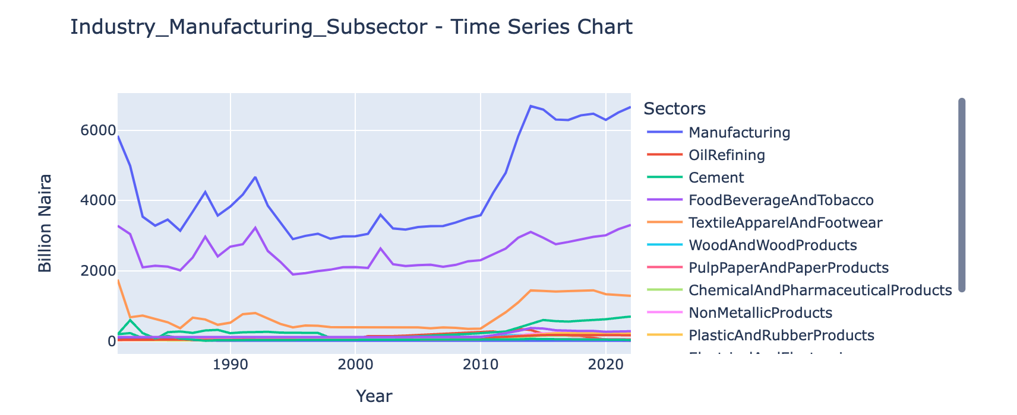
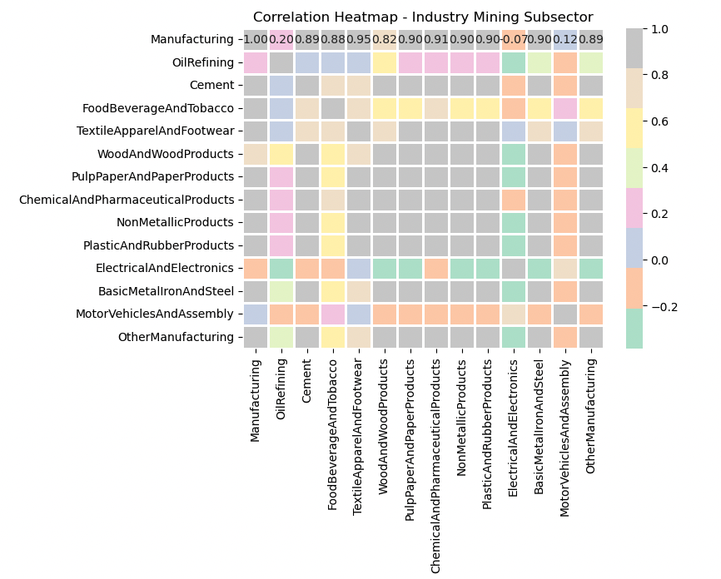
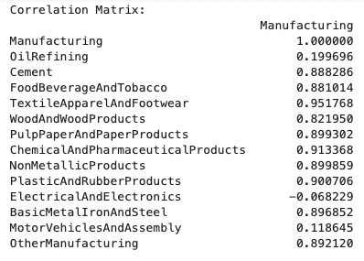
Sector and Subsector Analysis (4/4)
Industry Manufacturing Subsector
The Food and Beverage subsector dominated the Manufacturing sector, with Textiles and Apparels, Cement, and other manufacturing subsectors following in second, third, and fourth positions, respectively.
After an initial downward trend, the Food and Beverage subsector broke out around 2010 towards higher growth.
Textiles had the highest correlation (0.951) with the Manufacturing sector, followed by Chemical and Pulp and Paper Products. Electrical and Electronics Products showed a negative correlation with the sector, indicating an opposite trend compared to other subsectors within manufacturing.

Slide 24
Thank You!

